Slide 1
Computer Architecture: The Debugger & Embedded Systems
Dr. Colin O’Flynn

Slide 2
Objective of Today’s Lecture
What code did I write?
What code did the compiler generate?
How do we observe it running?
..This will lead into the first lab

Slide 3
Learning Objectives
What a debugger can and cannot know
Understand how debug symbols map source code to machine code
Observe and understand how optimizations change debugging

Slide 4
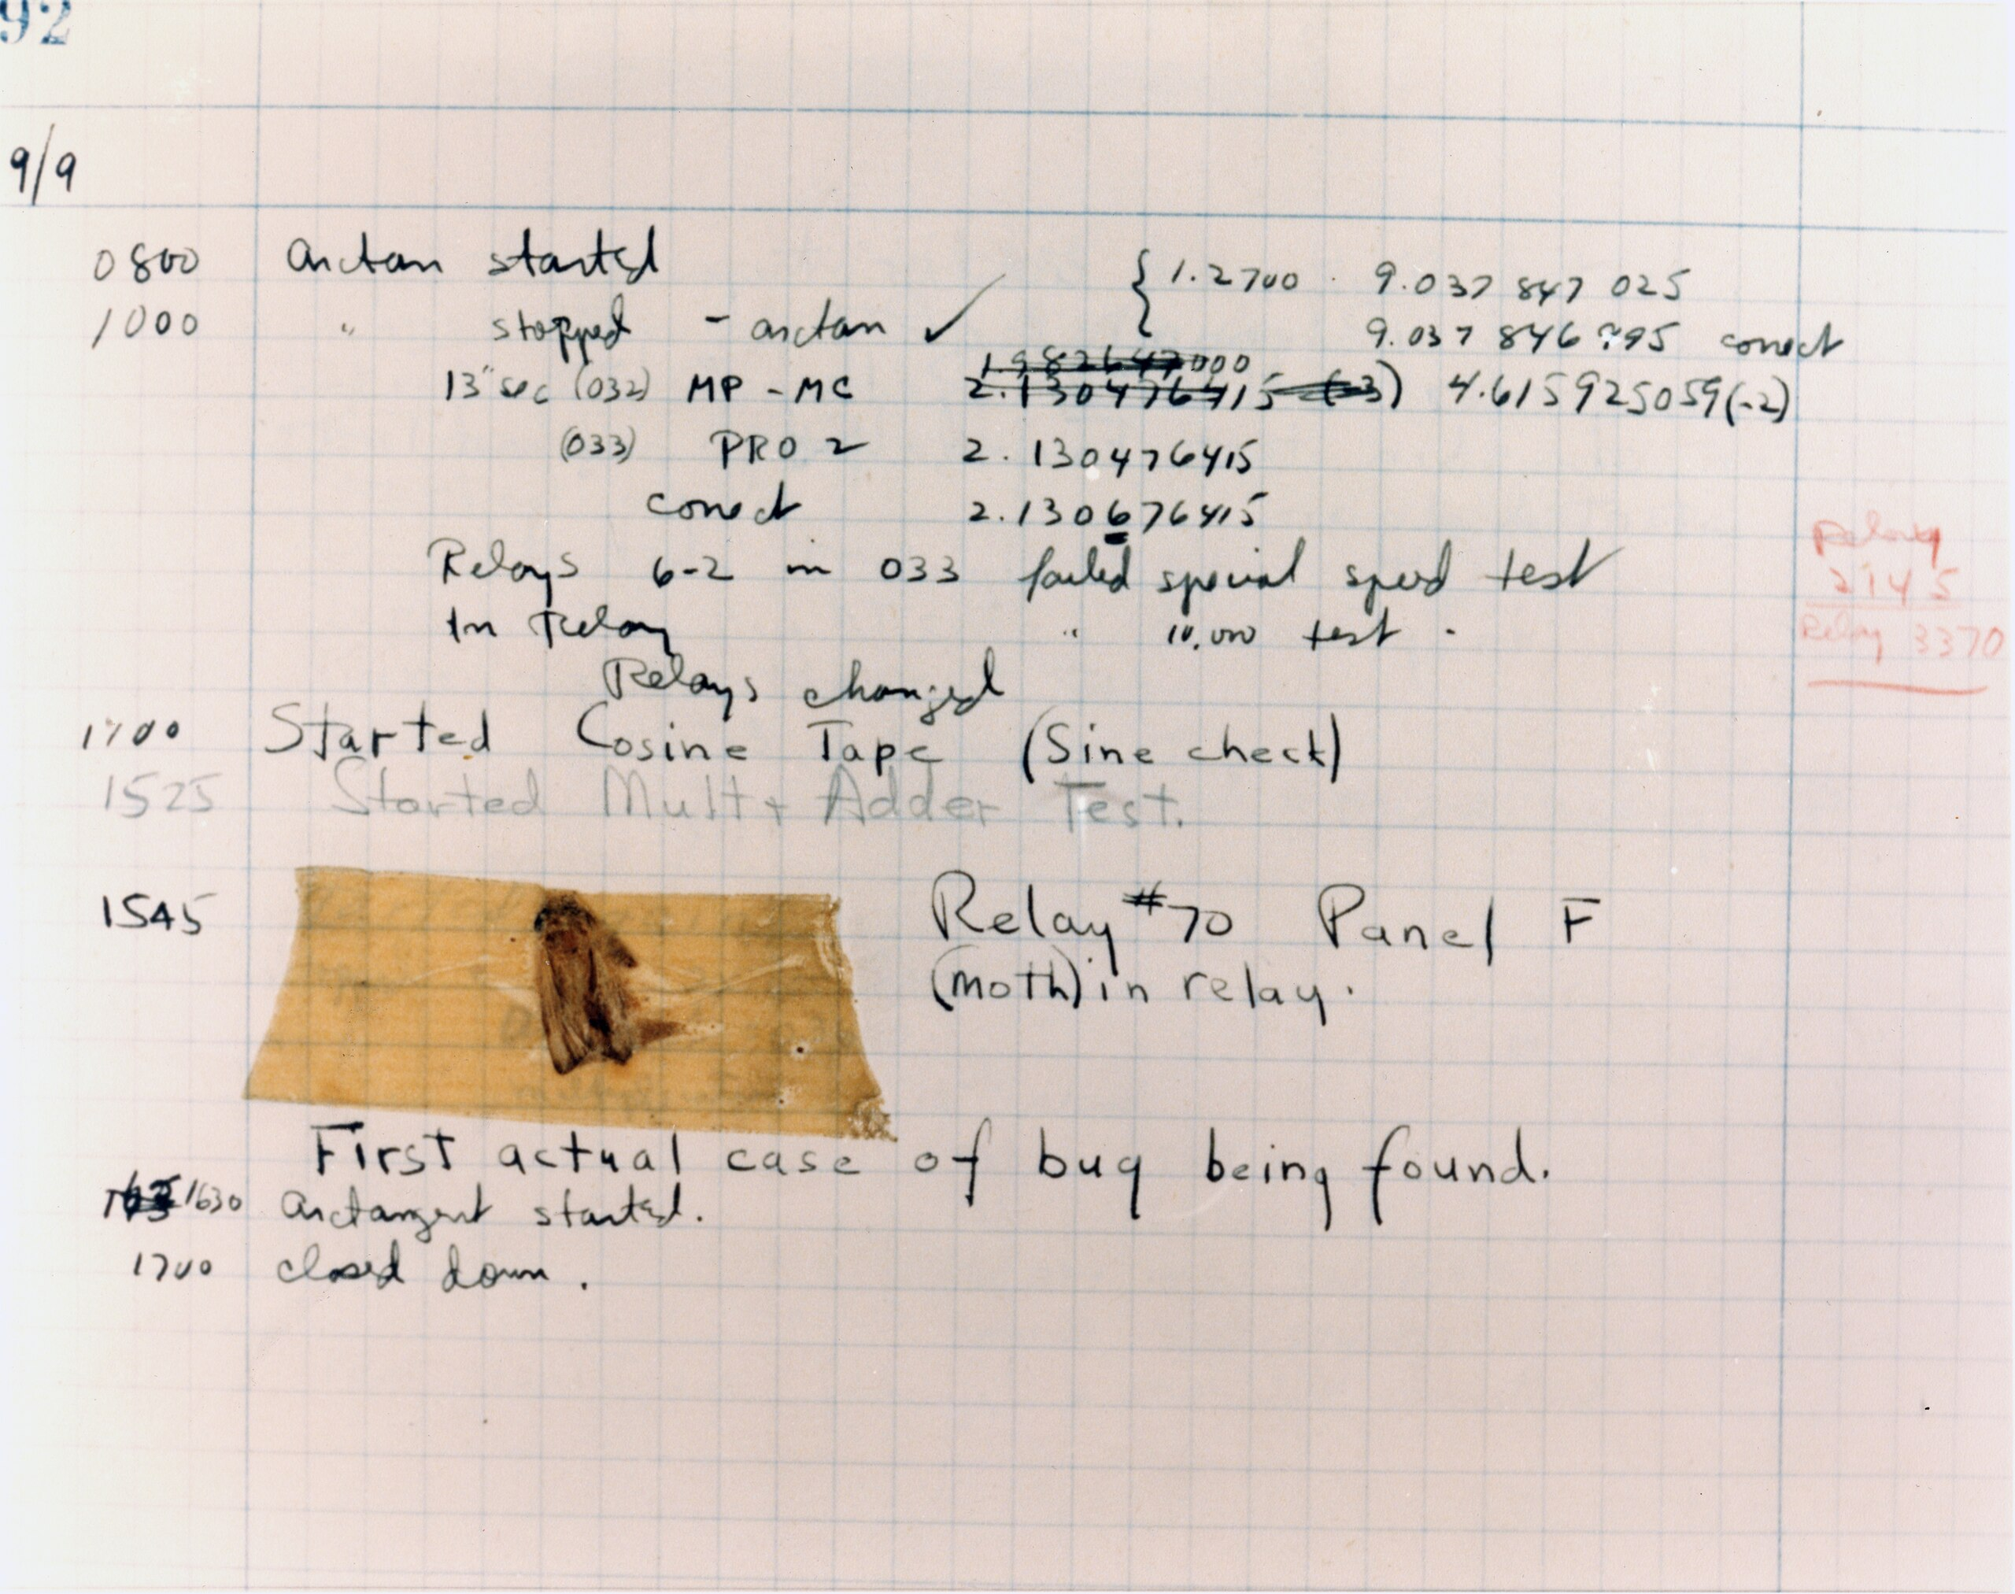
What is a bug?

Slide 5
What is a debugger?

Slide 6
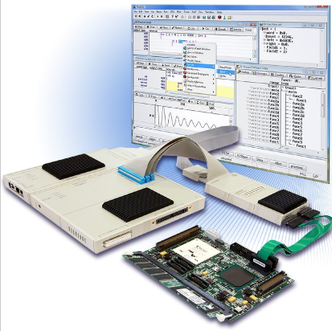
Debuggers & Emulators History

Slide 7
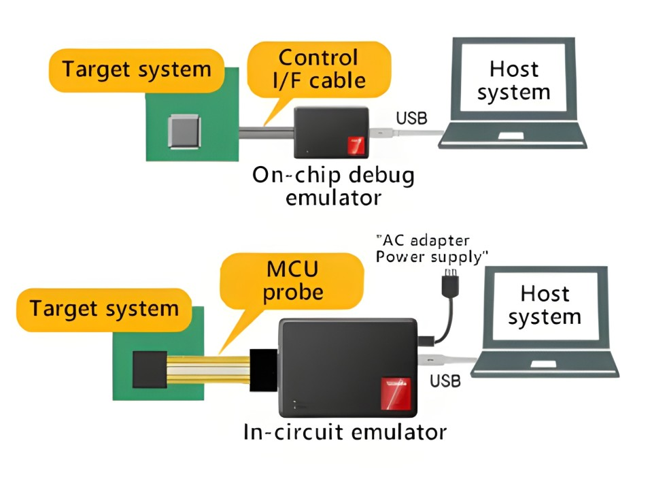
Debuggers: In Circuit Emulators & On-Chip Debug

Slide 8
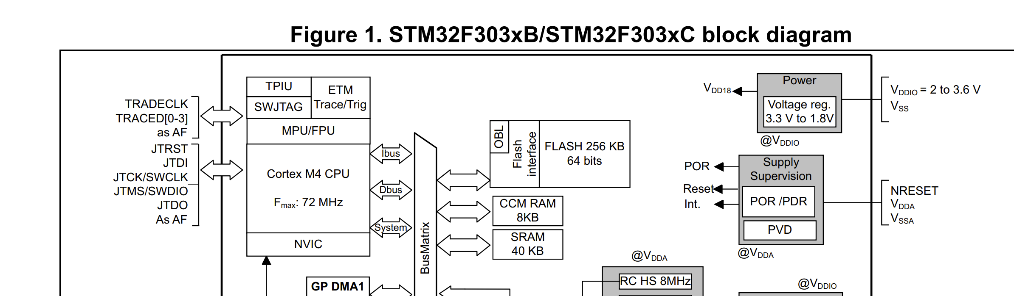
Cortex-M In-Circuit Debugger
99% of chips you use will have On-Chip Debug support

Slide 9
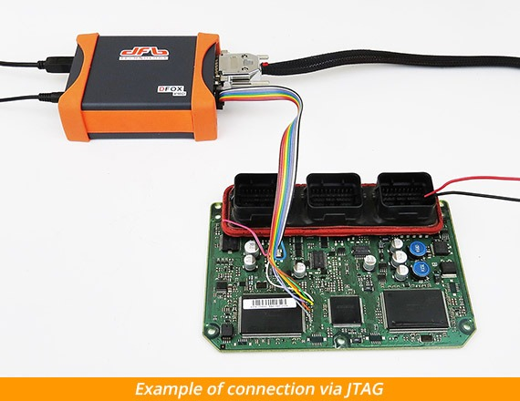
JTAG? SWD?
JTAG is a generic interface for connecting to devices for testing & debug.
A JTAG connection may connect to a debug “core” if the chip has one.
Arm devices may support a “smaller pin count” version of JTAG called Serial Wire Debug (SWD)

Slide 10
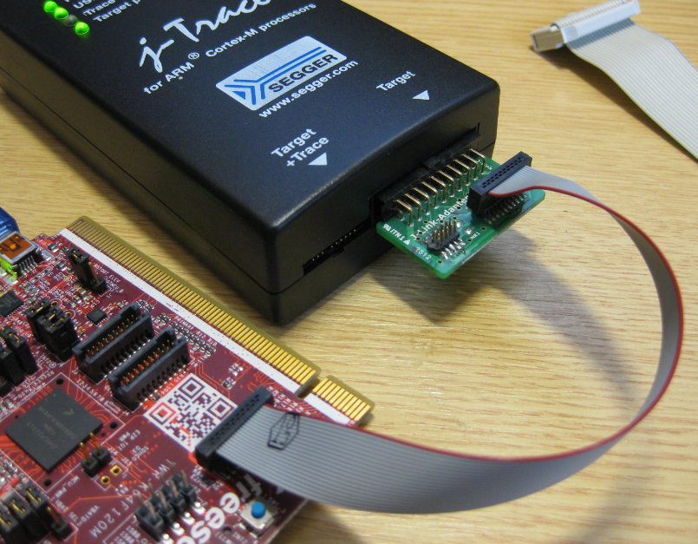
Debugger Connection to System
Debugger
Target System

Slide 11

Debug Monitors
Application
Program
Memory
&
Peripherals
$ read_mem 0x2001000, 16
00 00 01 FA FE 0B 0C 0D
AB 02 03 04 1E 00 20 22
Monitor Program

Slide 12
Debug Monitors
Less common now – these existed mainly when on-chip debuggers were not prevalent
The naming remains, we will often see references to a “monitor”
Monitors could break, step code, etc similar to a debugger

Slide 13
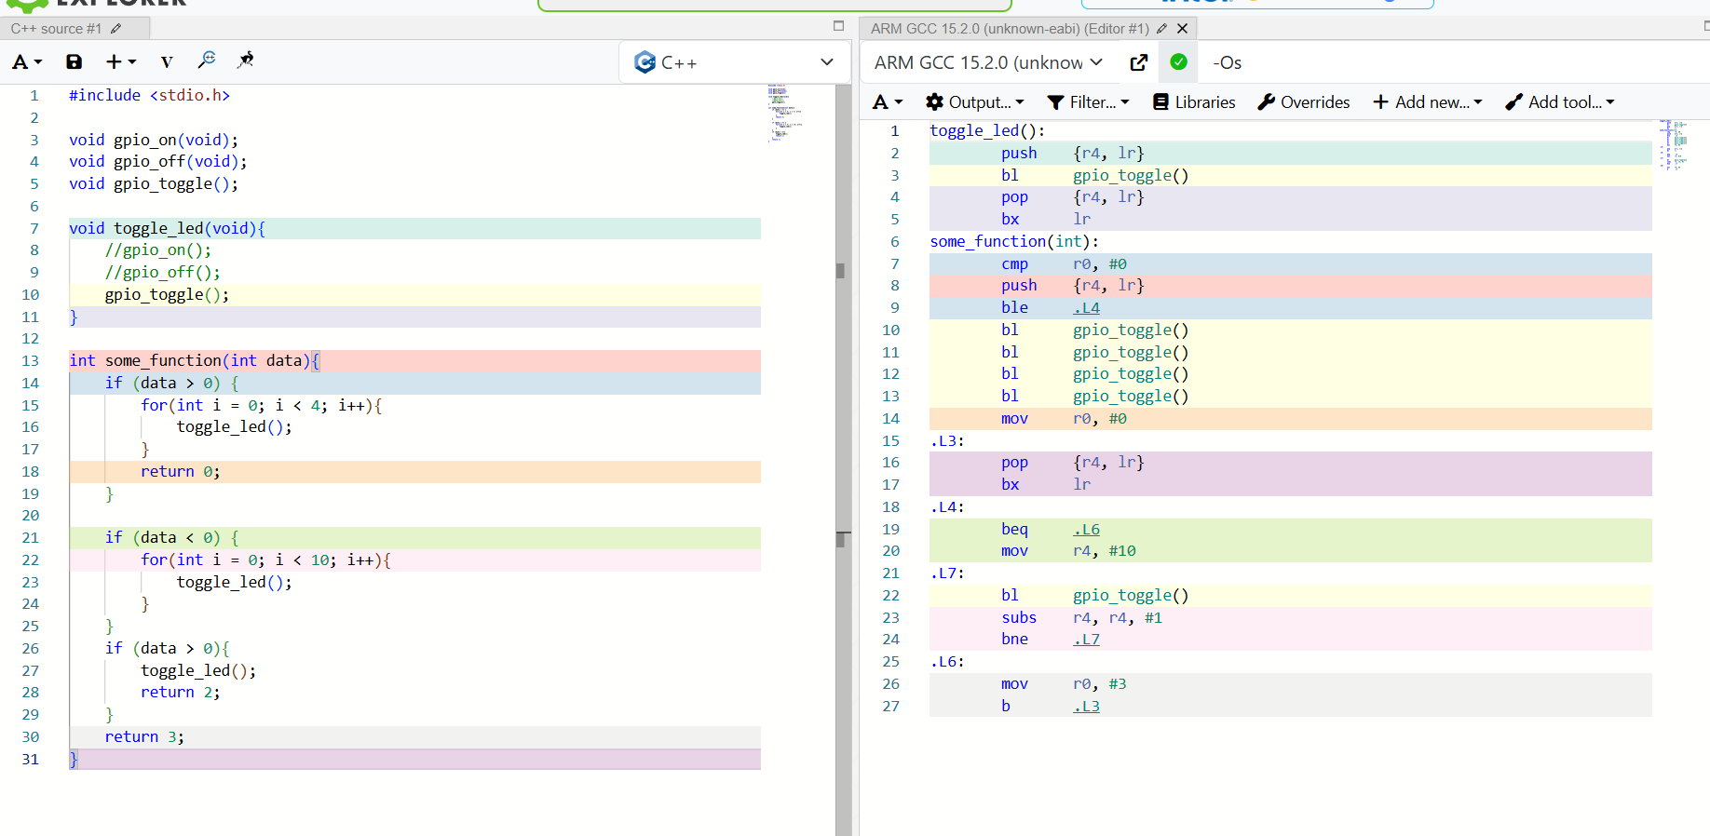
Debuggers & Source Code
What you want to see
What the debugger sees
(Debugger is also missing function names)

Slide 14
Debuggers & Source Code
What you want to see
What the debugger sees
(Debugger is also missing function names)

Slide 15
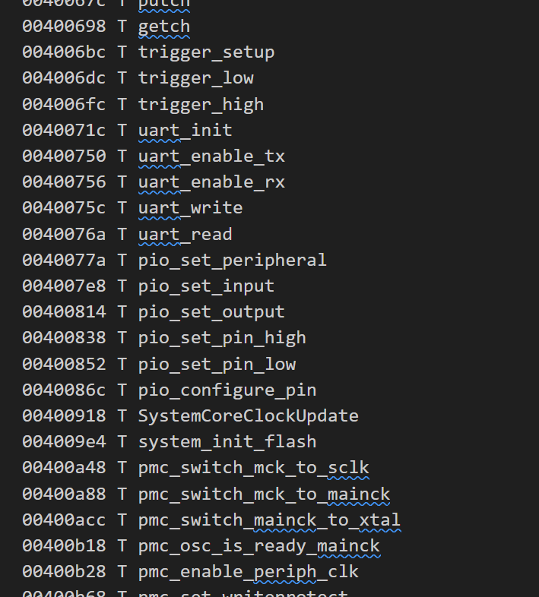
Debug Symbols
Map function names, static variables, etc to addresses:
NOTE: This doesn’t include optimized away variables…

Slide 16
Debugger Tool #1: Breakpoints
Breakpoints cause execution to “break” (stop)
Control is passed to the debug core / tool at this point

Slide 17
Code & Data Breakpoints
You set a match on some condition that causes the break
Most commonly we break on a program location (code breakpoint)
You can also break on data read/write ("data breakpoint" or "watchpoint")

Slide 18
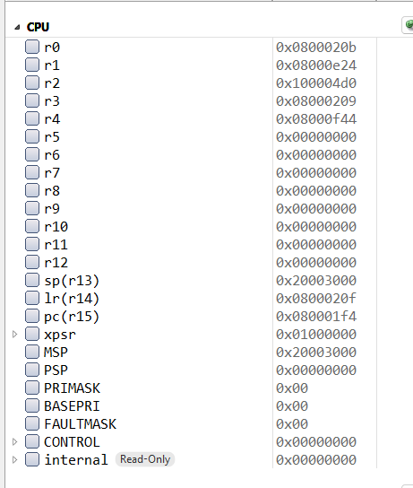
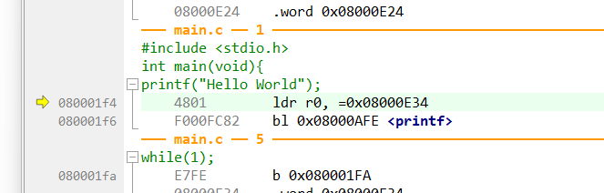
The Program Counter
Will return to this when we talk more about CPU cores, but quickly:

Slide 19
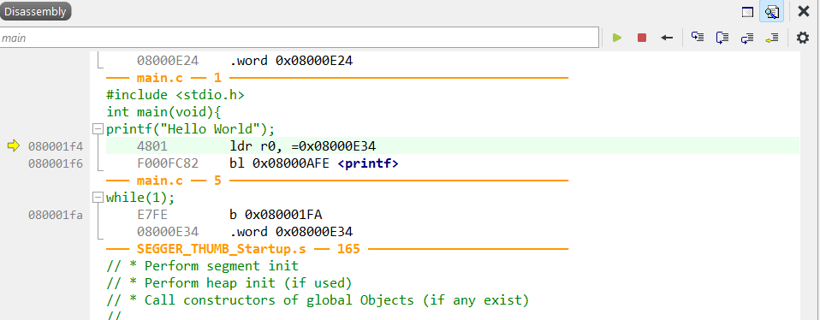
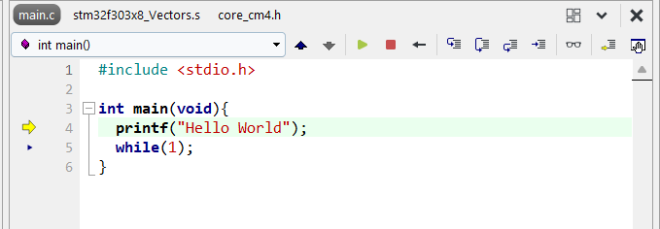
Assembly vs. C Stepping

Slide 20
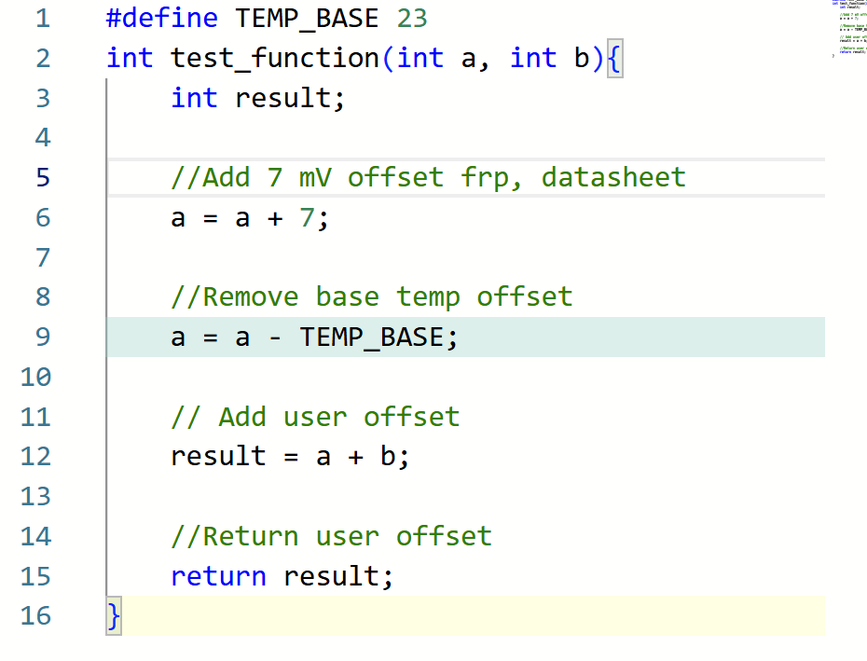
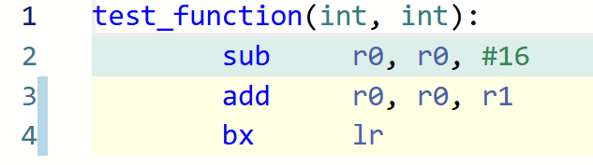
e.g., Many source lines → Fewer Assembly Line

Slide 21
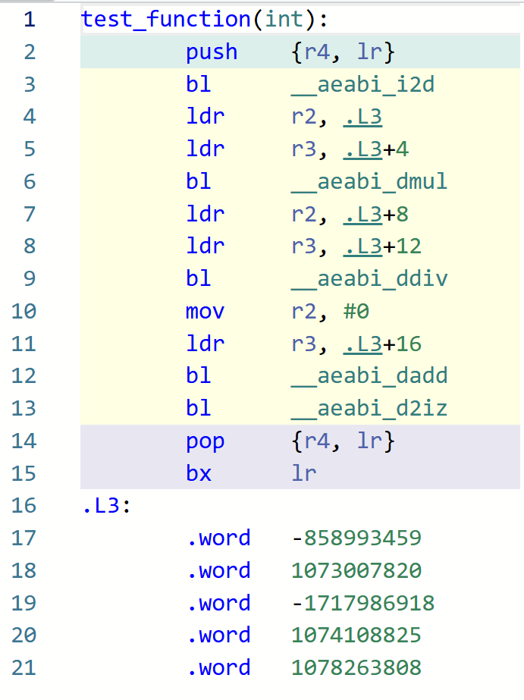
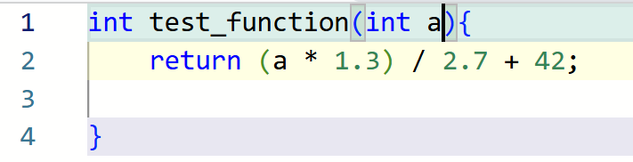
e.g., One Source Line → Many Assembly Lines

Slide 22
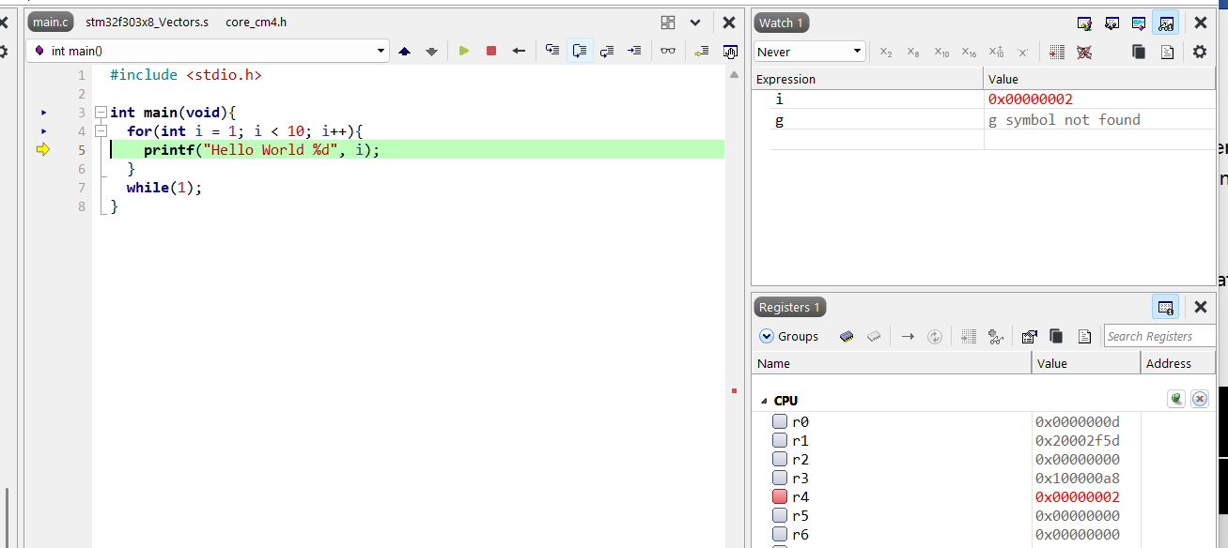
Register Your Trust

Slide 23
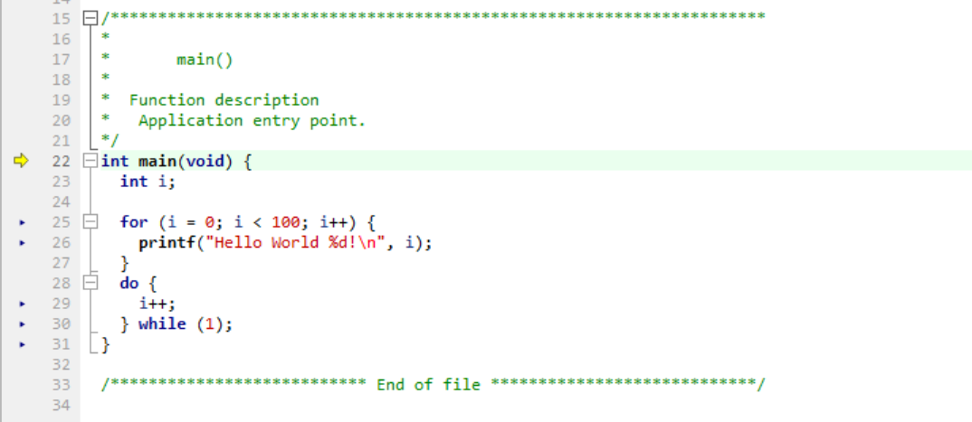
Simple Loop Example

Slide 24
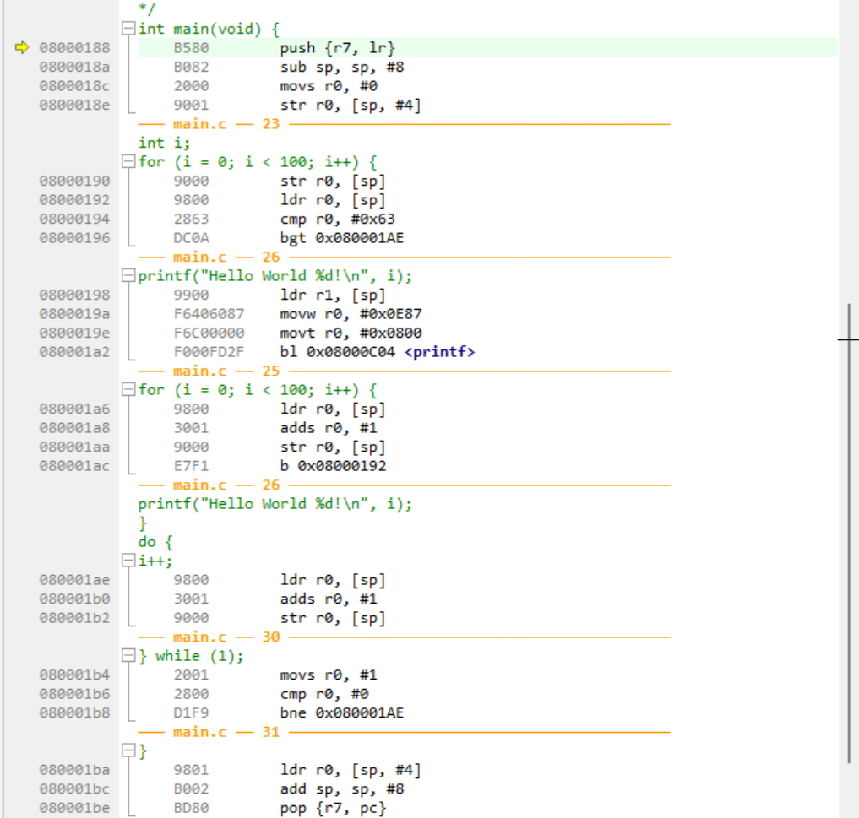
Simple Loop Example

Slide 25
SIDEBAR: Makefile vs. IDE Configuration
Many systems will use a Makefile that has all the compiler options stored in it. You modify the Makefile to change build options (optimization levels etc).
Some Integrated Development Environments (IDEs) allow you to configure this instead – the IDE builds the command based on options you select.

Slide 26
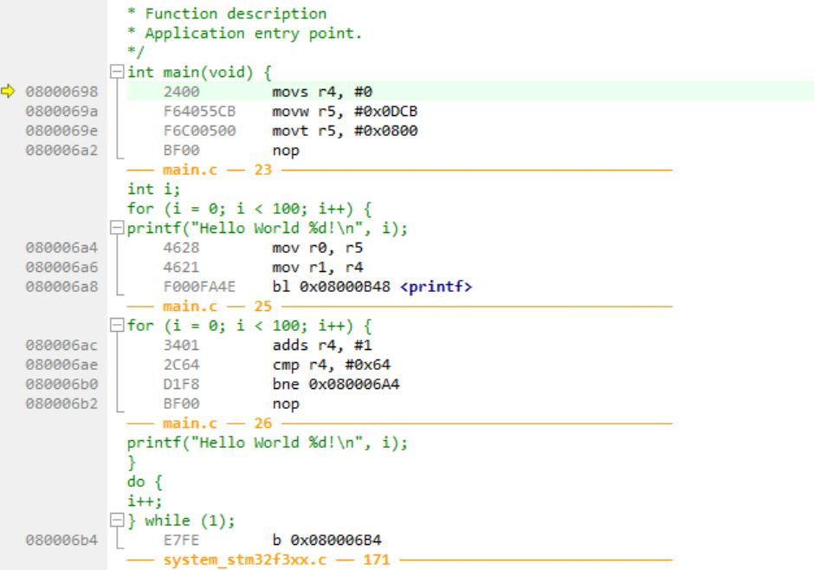
Simple Loop Example, Again (Optimized)

Slide 27
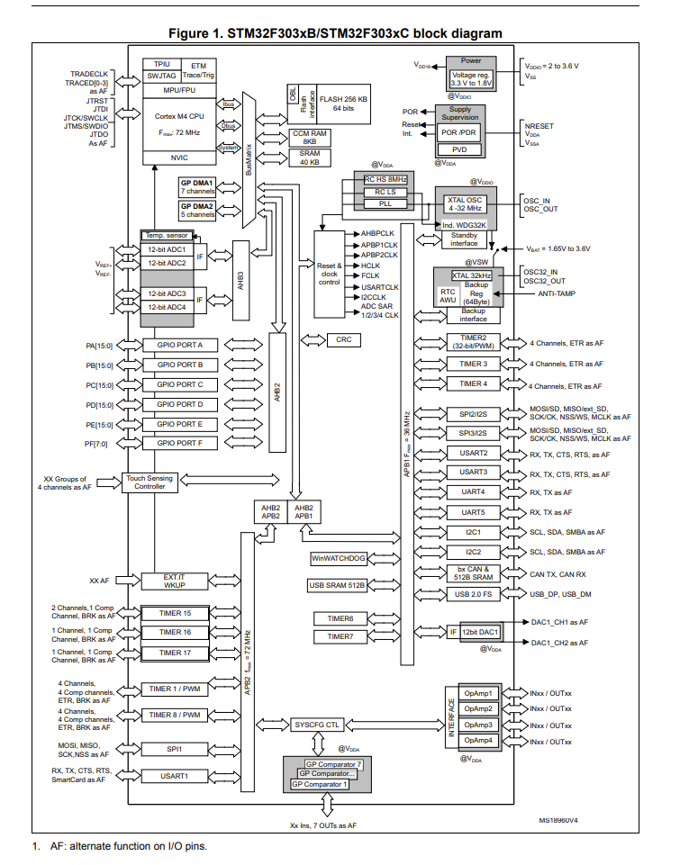
Debugger Side Effects
The debugger is pausing your program
The debugger is not pausing the entire world

Slide 28
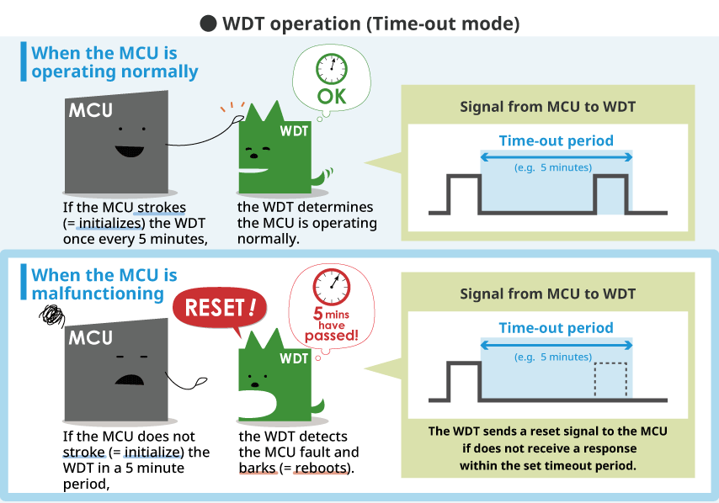
Debuggers & Watchdog Timers (WDT)

Slide 29
Debuggers & Watchdog Timers (WDT)
WDT often have short timeouts (< 100 mS).
If you pause the debugger for longer than that the WDT will reset the system.
You may need to disable the WDT in the source code of your system for debugging.
CAVEATS:
Some debuggers have an option to automatically detect & do this.
Some WDT built into microcontrollers have a way to pause during debug

Slide 30
Debuggers & Interrupts
Interrupts often are time-sensitive – they interface to the outside world
The debugger stops only the core from running – peripherals are often still working (generating interrupts), e.g.:

Slide 31
e.g., Timer Example
You setup a timer to interrupt every 250 mS
Timer
LED Blink Code
Main Application Code

Slide 32
e.g., Timer Example
When attemping to step the main code, you will keep hitting the timer interrupt code
WHY: Every 250 mS the timer sets an interrupt flag. At which point the CPU jumps to the interrupt. So you are now continuously debugging the interrupt…

Slide 33
Debuggers & UART
Similar issues if your device is talking to an external board – the UART interrupt may fire on received data.
You may need to modify your system for debugging!
Some debuggers offer options to:
Pause timer peripherals
Automatically allow execution of interrupts

Slide 34
Debuggers & USB
If you ever need to debug a USB device – this is very annoying, as the device will “time out” from Windows if it stops responding for more than a few seconds!
Need to quickly pause & restart device…

Slide 35
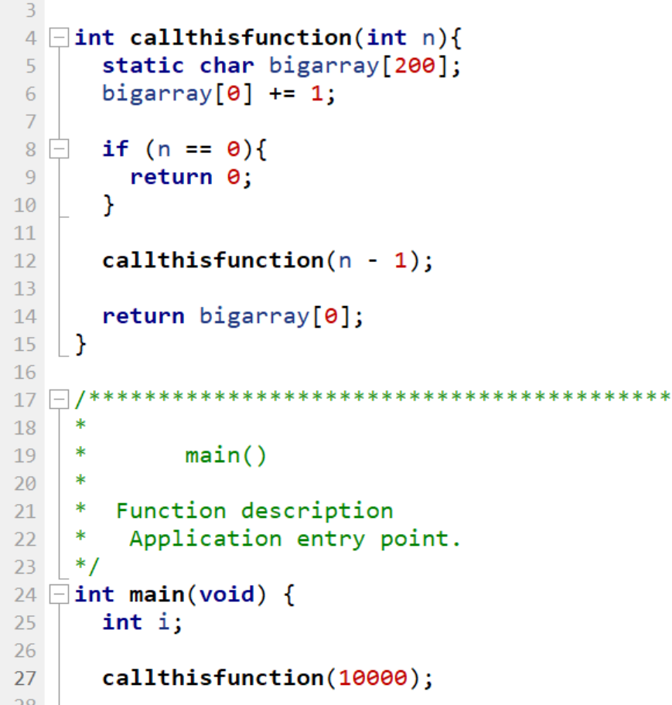
e.g., Triggering Crashes with Recursion

Slide 36
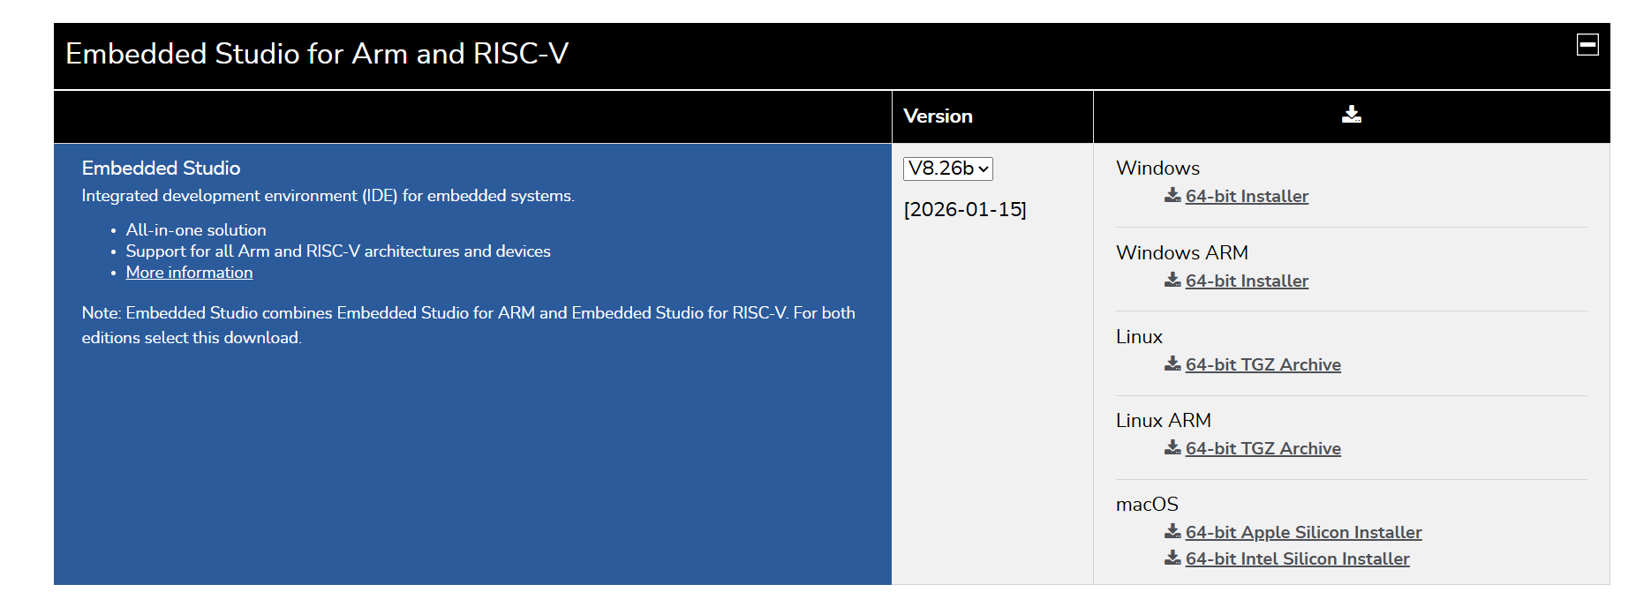
Compiler + Debugger Install (Lab Prep)
We are going to use an Integrated Debug Environment (IDE) from Segger in this course:
https://www.segger.com/downloads/embedded-studio/

Slide 37
Installation Work
Install SEGGER Embedded Studio.
You will be using this academically so can ACCEPT the license agreement (no license needed).
You will need to open the “Package Manager” (it may ask you this the first time) & get a list of packages

Slide 38
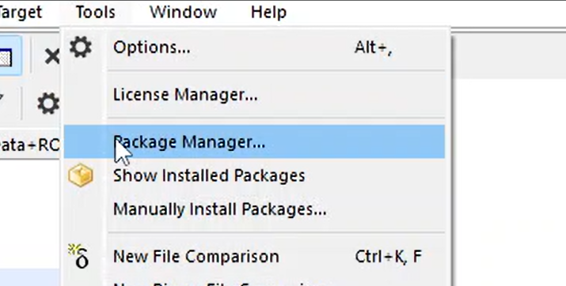
Installation Work (Cont’d)

Slide 39
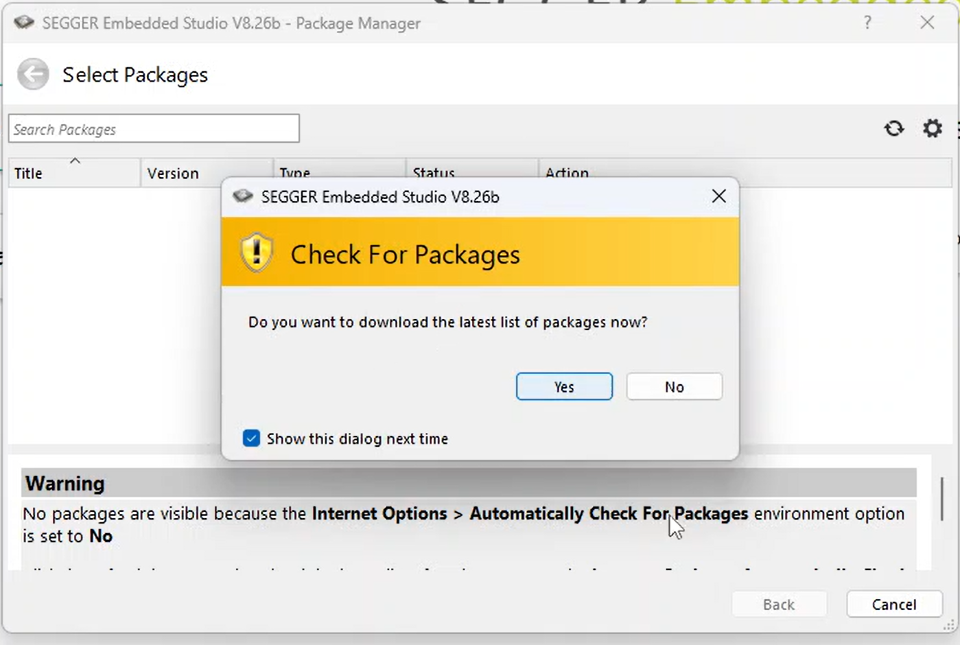

Slide 40
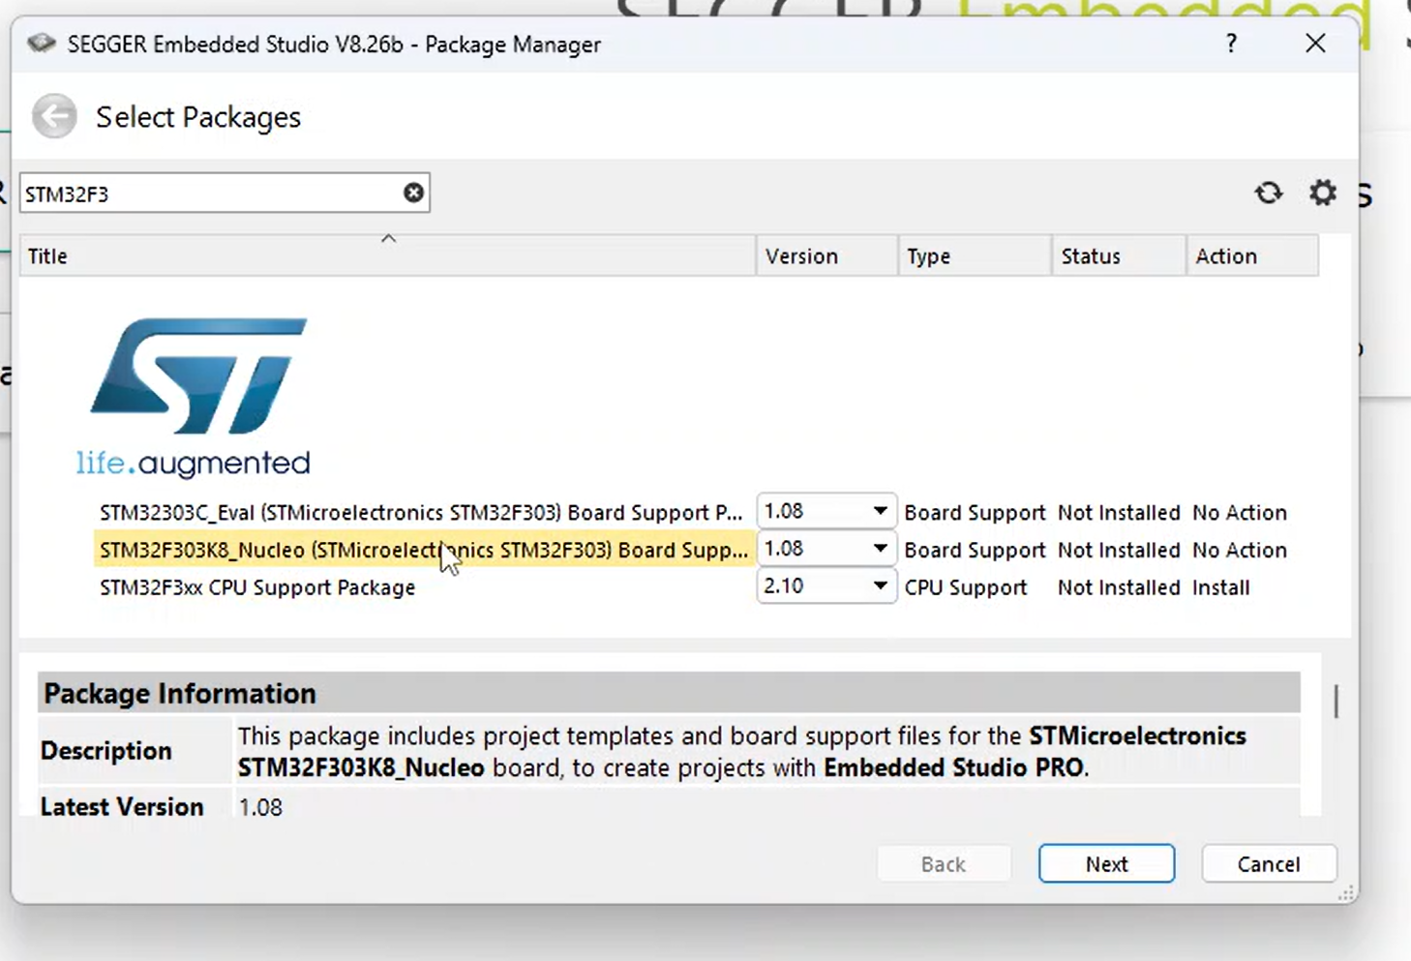
1. Search STM32F3
2. Right click on both of these & click "Install"
3. Click "Next"

Slide 41
Ready for Lab #1
Lab #1 can be done in small groups (1-3 people). Each person will check out a board as you may need to recreate parts of this for the assignment.
We'll explore the debugger usage & see how changes in optimization affect code, as well as understand how to use various debugger features.
The same setup will be used in the remaining labs in the course.

